Slide 1
Comparative study of Active anti disturbance control (AADC) & Conventional control
Presented By : Arnab Banerjee
Course : Masters in Control System Engineering
Department : Electrical Engineering
Roll Number : 001910804004

Slide 2
Introduction
What is disturbance ?
Importance of disturbance rejection in Control Systems
Inadequacy of Conventional control schemes to handling disturbance
Passive anti-disturbance control (PADC) schemes

Slide 3
Arrival of AADC
The first AADC scheme : The Feedforward control (FC) scheme
Limitation of FC scheme
Introduction of FC based Disturbance estimation techniques or Disturbance Observer-based control (DOBC)

Slide 4
Early History
Since 1970s, many techniques developed
Unknown Input Observer (UIO)
Perturbation Observer (PO)
Equivalent Input Disturbance (EID)-based estimator
Extended State Observer (ESO)
Disturbance Observer (DO)
DO (Prof. K.Ohnishi) and ESO (Prof. J.Han) are most extensively investigated
The analysis and design method for DO has achieved significant progress

Slide 5
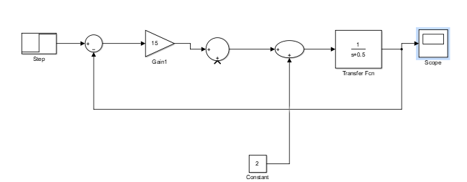
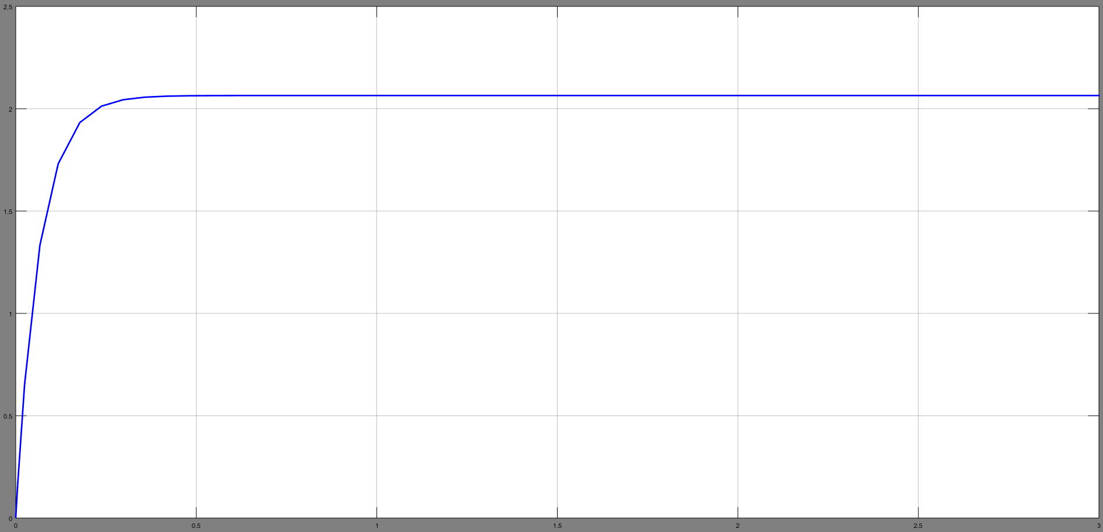
Motivation behind the DO
The Proportional Controller
Fig.1
Proportional Control with constant disturbance
Fig.2
Plant response with finite steady state error

Slide 6
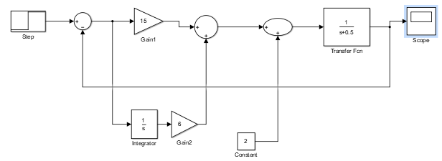
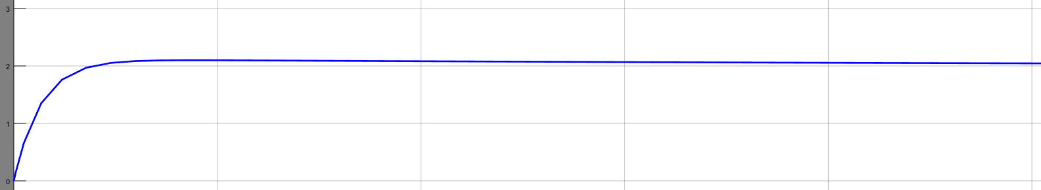
Motivation behind the DO
The Proportional Integral Controller
Fig.3
PI Control with constant disturbance
Fig.4
Plant response with diminishing steady state error

Slide 7
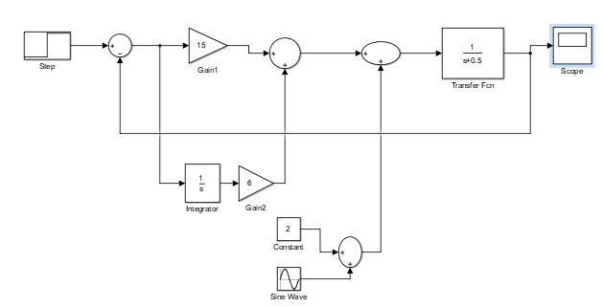
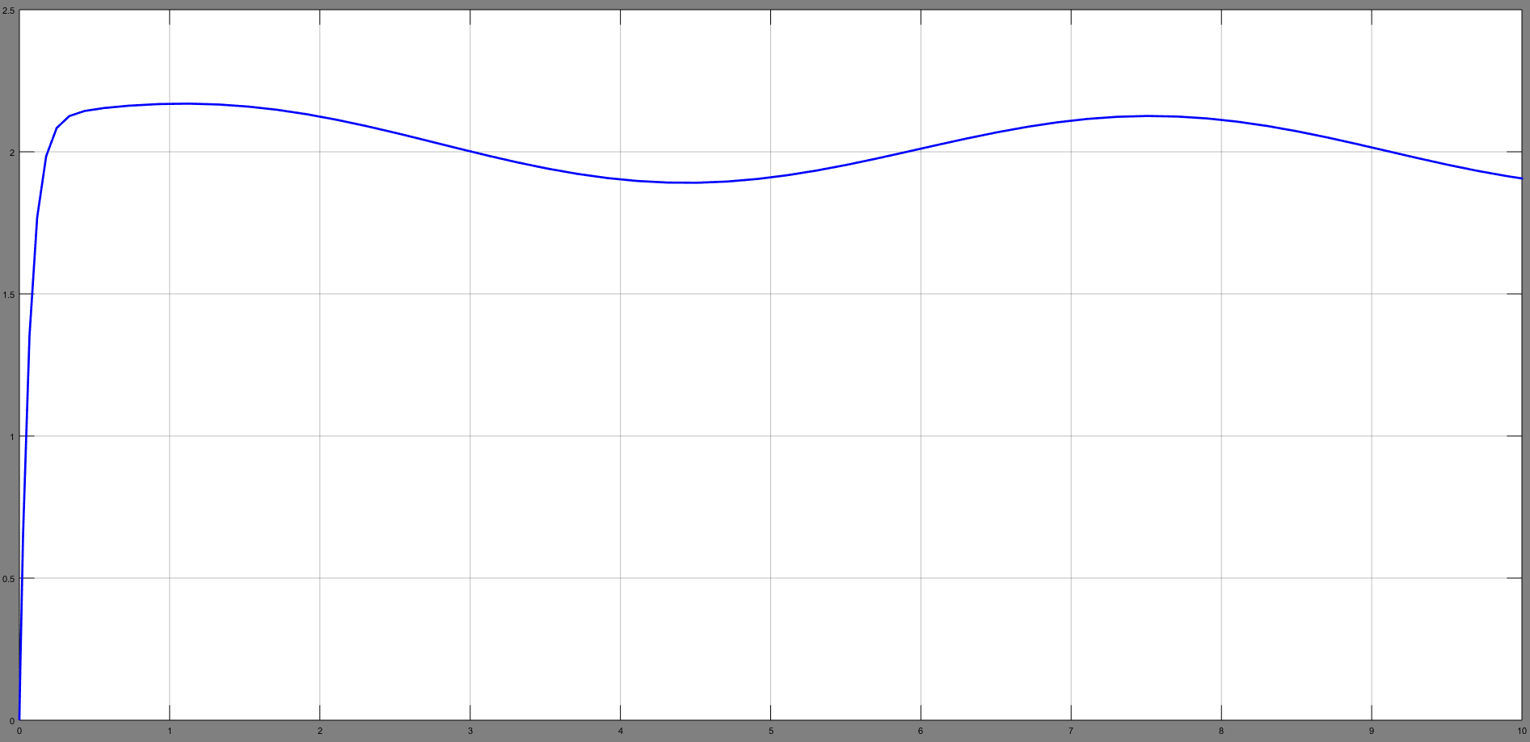
Motivation behind the DO
The Proportional Integral Controller
Fig.5
PI Control with constant and sinusoidal disturbance
Fig.6
Plant response with finite steady state error

Slide 8
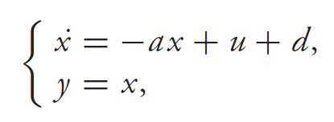

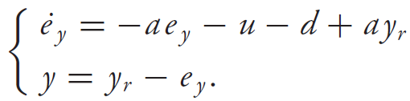
Control law for the DO
x is the state, u the control input, d the disturbance
a the system parameter, set point is y_{r}
Tracking error e_{y}
System dynamics w.r.t to tracking error
u=u(e_{y ,} y_{r})

Slide 9

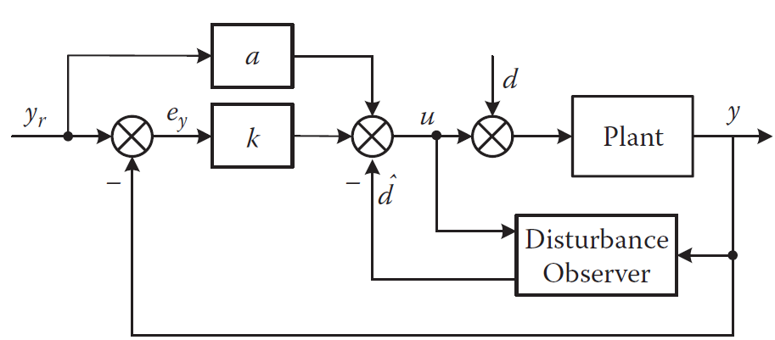
Block Diagram of DOBC
Fig.7
Block Diagram of DOBC

Slide 10
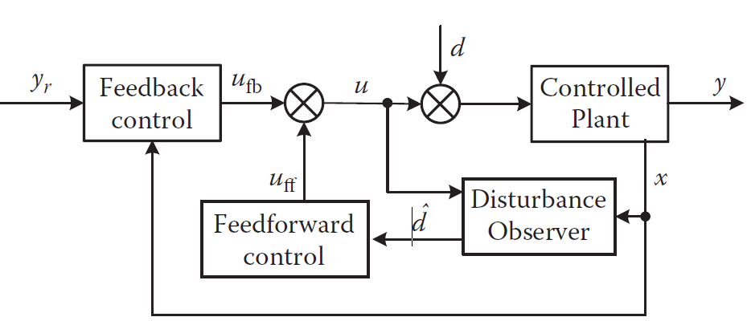
Basic Framework/Superiority of DOBC
Faster response in disturbance handling
“Patch” to the baseline control
Less conservativeness
Fig.8
Composite Controller demonstrating separation principle

Slide 11
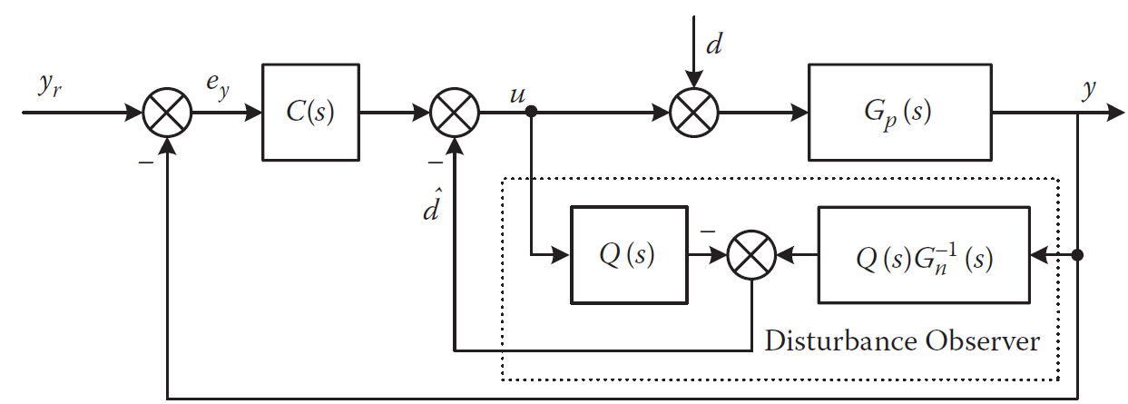
Frequency domain formulation of DOBC
G_{p}(s) is plant model
G_{n}(s) is nominal plant model
Q(s) is the filter transfer function
C(s) is the controller transfer function
Fig.9
Frequency domain formulation of DOBC

Slide 12


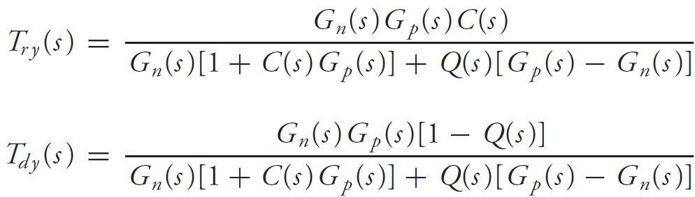
Frequency domain formulation of DOBC
Q(s) design important

Slide 13

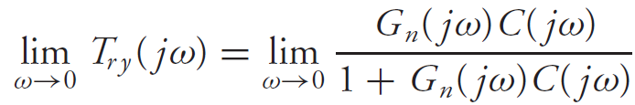

Frequency domain formulation of DOBC

Slide 14
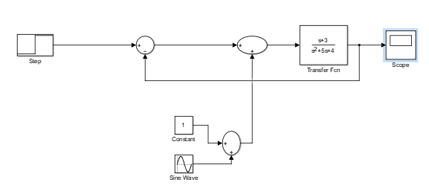
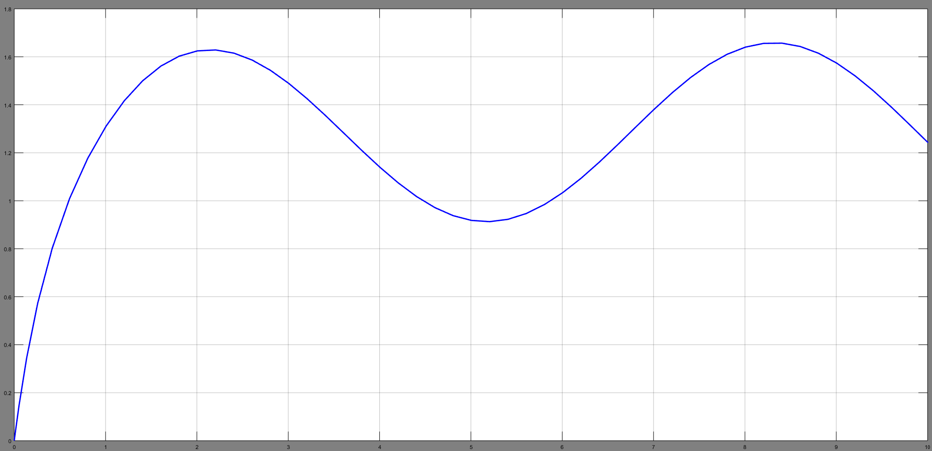
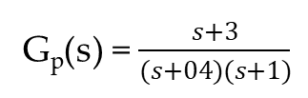
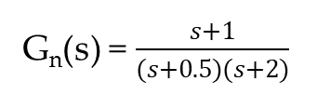
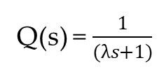
Demonstration : Frequency domain formulation of DOBC
G_{n}(s) = $\frac{s+1}{(s+0.5)(s+2)}$
G_{p}(s) = $\frac{s+3}{(s+04)(s+1)}$
Q(s) = $\frac{1}{(λs+1)}$
Fig.10
Effect of sinusoidal disturbance

Slide 15
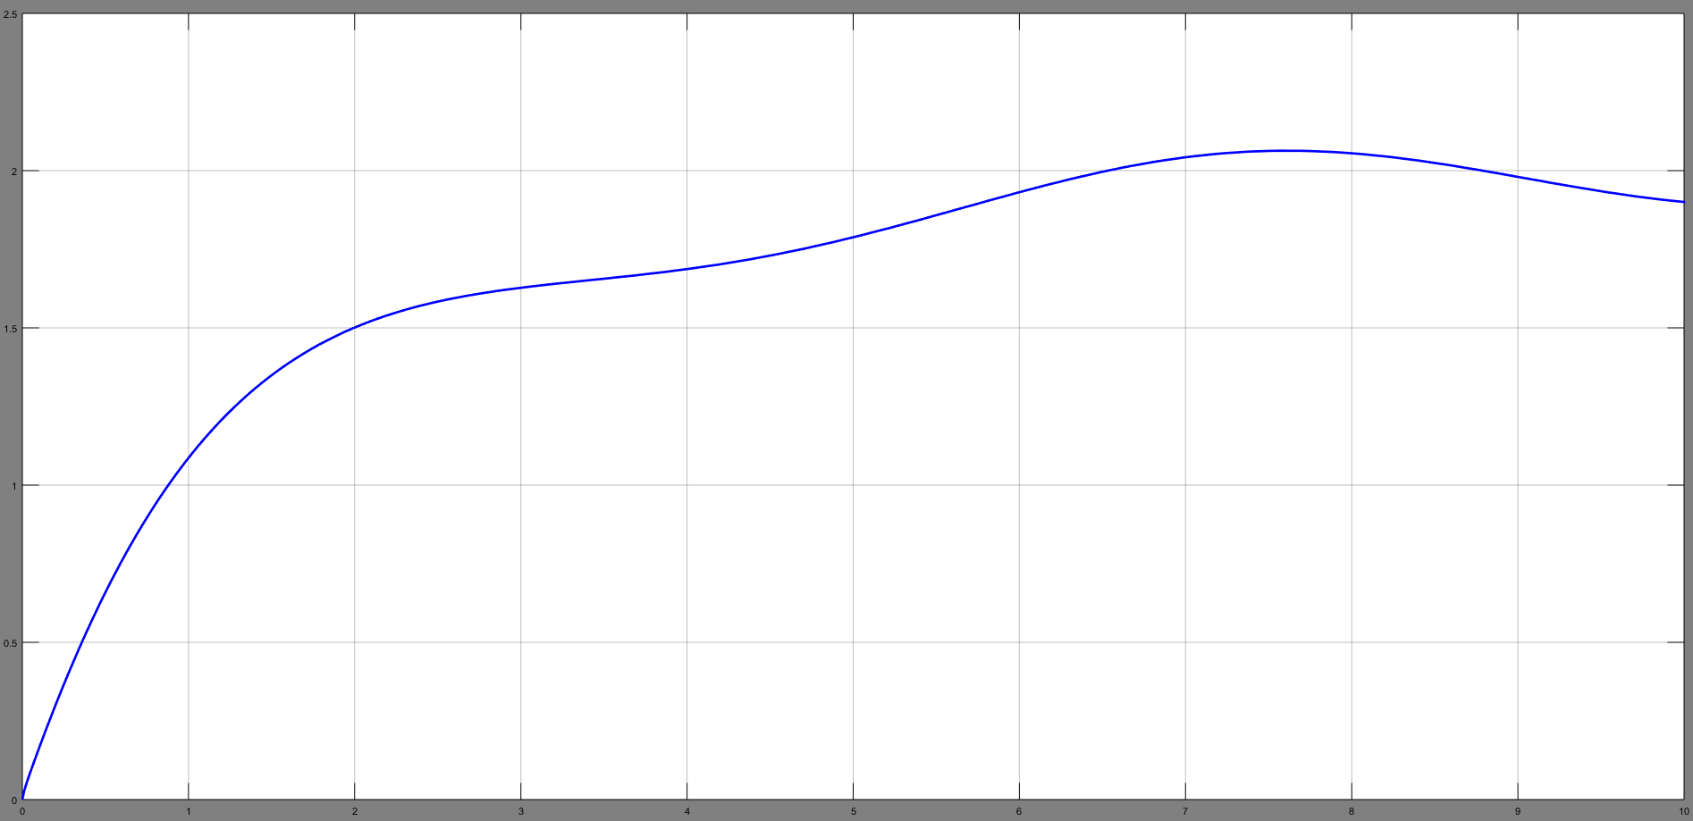
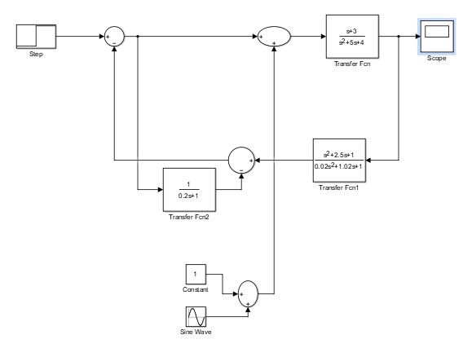
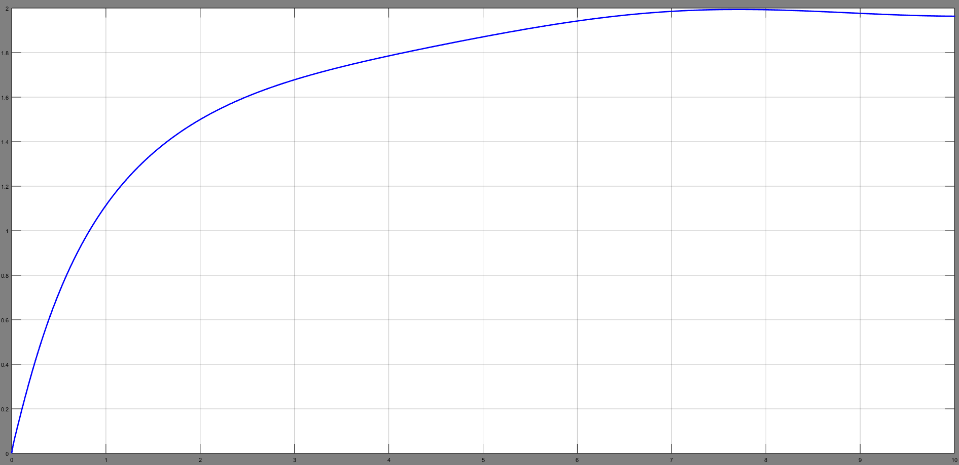


Demonstration : Frequency domain formulation of DOBC
Q(s) = $\frac{1}{(0.2s+1)}$
Q(s) = $\frac{1}{(0.05s+1)}$
Fig.11
DOBC Controller demonstrating sinusoidal disturbance rejection

Slide 16
Remaining topics to be discussed
Disturbance estimator design
Non-Linear disturbance observer

Slide 17
References
Chen, Wen-Hua. "Disturbance observer based control for nonlinear systems." IEEE/ASME transactions on mechatronics 9.4 (2004): 706-710.
Li, Shihua, et al. Disturbance observer-based control: methods and applications. CRC press, 2016.
Yang, Jun, W-H. Chen, and Shihua Li. "Non-linear disturbance observer-based robust control for systems with mismatched disturbances/uncertainties." IET control theory & applications 5.18 (2011): 2053-2062.

